Slide 1

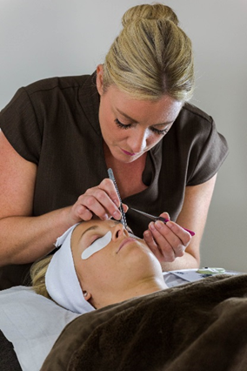
11.02.11
June 2016 – Beauty SVQ launch event
Emma Mackay
City & Guilds

Slide 2

AGENDA
    Beauty NOS
    New Qualification structures
    Key changes
    Evidence requirements
    Delivery
    Assessment strategy
    Knowledge requirements
    Values, behaviours & sustainable working practices
    Resources and support material
© CITY & GUILDS

Slide 3



















EMPLOYER SUPPORT…..Beauty/Spa Therapy
QUALIFICATIONS DESIGNED WITH LEADING EMPLOYERS
© CITY & GUILDS

Slide 4










EMPLOYER SUPPORT…..Beauty/Spa Therapy
QUALIFICATIONS DESIGNED WITH LEADING EMPLOYERS
© CITY & GUILDS

Slide 5

Updated National Occupational Standards for Beauty Therapy and related subjects – February 2015
Mapping documents completed to outline key changes to the NOS for Beauty Therapy
City & Guilds website:
http://www.cityandguilds.com/qualifications-and-apprenticeships/beauty-and-complementary-therapies/key-documents

Slide 6

Activity…….
Mapping documents – comparison from old to new NOS
Explore key differences

Slide 7
Beauty SVQ’s
Current Beauty SVQ qualifications lapse end of July 2016
All Awarding Organisations are working with Skills Active regarding accreditation of new qualifications ready for 1st August 2016
New qualifications being developed:
SVQ Level 2 in Nails at SCQF Level 5
SVQ Level 2 in Beauty Therapy at SCQF Level 5
SVQ Level 3 in Nails at SCQF Level 6
SVQ Level 3 in Beauty Therapy at SCQF Level 6
HABIA products are currently approved with the current titling formula – titling convention may change for new SVQ’s

Slide 8

Direct replacements ……
The qualifications being replaced are:
SVQ 2 in Beauty Therapy 28 July 2010 to 31 July 2016
SVQ 3 in Beauty Therapy 1 August 2010 to 31 July 2016
SVQ 2 in Nail Services 28 July 2010 to 31 July 2016
SVQ in Nail Services 28 July 2010 to 31 July 2016

Slide 9
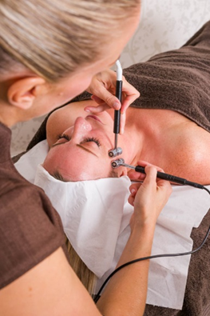



NEW Beauty & nail structures

Slide 14

So what has changed or been updated??

Slide 15
Assessment –
Practical observations
Assessment strategy MUST be followed
Practical observations – range, evidence and number of observations stipulated
Require candidates to demonstrate their practical skills
Log books and units will be available to be downloaded
Carried out in a Realistic Working Environment (RWE)
The service times are flexible, Assessors should use their
professional discretion, particularly for situations where client
factors would require additional time in normal commercial
setting.
This is to be discussed with the learner so an agreed service
time is confirmed at the beginning of the service and recorded
Step
1

Slide 16
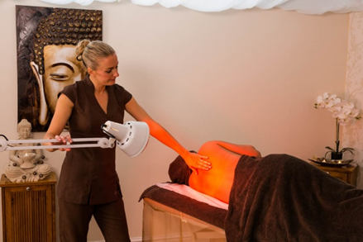


Assignment/Assessment Guide for Centres
Activity – explore key changes within this guide

Slide 17
Knowledge requirements
    Inferred Knowledge
    Covered through observation
    Cross Unit Knowledge Test – Level 2 & 3
    Closed book test using short answer questions or on line evolve test. 70% pass required under closed book conditions,
    then topped up to100% using oral or written questioning.
  Mandatory Written questions
    Closed book tests using short answer questions or on line evolve tests
    70% pass required under closed book conditions – no need to top up to 100%
  Assignments – Level 3
  Instruct clients in the use and application of skin care products and make-up
  Carry out Nail art services
  Design and create Nail art
  Develop a range of Creative Nail designs
  Contribute the planning, implementation and evaluation of promotional activities
  Contribute to the financial effectiveness of the business
Step
2

Slide 18
Assessment guidance
    Simulation is not acceptable for any units within this qualification
    Witness testimony should only be used as an additional method of Assessment when minimum amount of stated observations have been carried by an Assessor
    The Assessor must hold, or be working towards, a valid assessor’s qualification based on LSIS, formally LLUK, Learning and Development National Occupational Standards (2010)
    A minimum of 30 hours CPD is required per annum –
    no pro rata
    The Internal Verifier must hold, or be working towards, a valid verifier’s qualification based on LSIS, formally LLUK, Learning and Development National Occupational Standards (2010)
Step
3

Slide 19
Documentation
You will need the following:
    Point 1: Qualification Handbook – this is your teaching syllabus, which contains the National Occupational Standards and Evidence Requirements
    Point 2: Assessment Guidance documentation – this is your information on how and what the learners will be assessed on and how
    Point 3: Question papers – include short answer questions, assignments and marking guides for each level 2 & 3 unit
    Point 4: Log Books – this will be the learners record of practical observations completed
    Point 5: on line test available for each unit information will be found in the qualification handbook.
Step
4

Slide 20
Qualification handbooks
Activity – explore key changes within the handbooks

Slide 21
Re-cap
Service times
Test conditions
Inferred Knowledge
CPD
Structures
Level 3 Assignments
NOS Comparison document
Beauty & Nail options
Paying clients

Slide 22
            Environmental and sustainable working practices
The different types of working methods that promote environmental and sustainable working practices
reducing waste and managing waste (recycle, reuse, safe disposal)
reducing energy usage (energy efficiency hairdryers, low energy lighting, utilising solar panels)
reducing water usage and other resources
preventing pollution
using disposable items
using recycled, eco friendly furniture
using low chemical paint
using organic and allergy free products
using ultra-low ammonia products
using environmentally friendly product packaging
choosing responsible domestic products (fairtrade tea and coffee)
© CITY & GUILDS

Slide 23
            Values
The following Key Values underpin the delivery of services in the hair and beauty sector:
1.1 a willingness to learn
1.2 the completion of services in a commercially viable time
1.3 meeting both organisational and industry standards of appearance
1.4 ensuring personal hygiene and protection meets accepted industry and organisational requirements
1.5 a flexible working attitude
1.6 a team worker
1.7 maintaining customer care
1.8 a positive attitude
1.9 personal and professional ethics
1.10 the ability to self manage
1.11 creativity skills
1.12 excellent verbal and non-verbal communication skills
1.13 the maintenance of effective, hygienic and safe working methods
1.14 adherence to workplace, suppliers or manufacturers’ instructions for the safe use of equipment, materials and product
© CITY & GUILDS

Slide 24
            Behaviours
The following behaviours underpin the delivery of services in the hair and barbering sector. These behaviours ensure that clients receive a positive impression of both the salon and the individual meeting the salon's standards of behavior greeting the client respectfully and in a friendly manner communicating with the client in a way that makes them feel valued and respected identifying and confirming the client's expectations treating the client courteously and helpfully at all times keeping the client informed and reassured adapting the behavior to respond effectively to different client behavior responding promptly to a client seeking assistance selecting the most appropriate way of communicating with the client checking with the client that you have fully understood their expectations responding promptly and positively to the clients' questions and comments allowing the client time to consider the response and give further explanation when appropriate quickly locating information that will help the client giving the client the information they need about the services or products offered by the salon recognising information that the client might find complicated and checking whether they fully understand explaining clearly to the clients any reasons why their needs or expectations cannot be met
© CITY & GUILDS

Slide 25


How can we support you?

Slide 26
Tutor support materials………
Each qualification has its own handbook
Assignment/Assessment guide for Centre for the 6011 suite of qualifications
Down loadable log book and units
Support visits
Events

Slide 27
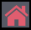
TEXT BOOKS
This textbook includes:
• Step-by-step photo guides to the technical skills
• Workplace values and behaviours, signposted in each technical unit
• Handy hints and useful words to aid understanding
• Practical activities to help apply knowledge to practice
• Essential maths and English skills embedded in real-world scenarios
• Test Your Knowledge questions
• Eye-catching design to engage and inspire.
ISBN: 9780851933634
Code: TB036003
Price: £27.99
Published: June 2016
Notes:
We will now look at the two main elements of TechBac in more detail, starting with Technical Qualifications.
Our new City & Guilds Technical qualifications have been designed and endorsed by employers, providing up to date and highly relevant skills with graded assessments. A practical and applied approach to assessment ensures that staff have more time to focus on teaching and learning, for more successful outcomes.
Technical qualifications are comprised of the following elements:
Synoptic assessment – this is assessment in which two or more areas of learning are brought together in a single assessment. This approach has been adopted for this qualification in order to help learners make connections between areas of learning and to promote holistic delivery and understanding of the subject. Synoptic assessments are comprised of a Practical Assignment and a written Examination.
The assignments are externally set, internally marked and externally moderated, and are designed to assess a specific optional task or area of the qualification. To do this, the candidate will be required to identify and use effectively an appropriate selection of skills, techniques, concepts, theories and knowledge from across the whole content area.
The examinations are externally set and externally marked, and will be sat online through City & Guilds’ computer-based assessment platform. The exam assesses the depth and breadth of the candidate’s understanding of the mandatory content of the qualification.
Employer Involvement - for the Key Stage 5 Technical Qualifications, Employer Involvement is a requirement that must be successfully met in order for learners to achieve the qualification. Although it does not contribute to the overall qualification grading, employer involvement in the delivery and/or assessment of these qualifications is essential for all candidates, and will therefore be externally quality assured by City & Guilds. The EQAs will review the centre employer involvement plans at approval stage, and then the Quality team will sample the evidence at cohort level, when the centre submits at the end of the academic year.
Optional Units - These assignments are externally set, internally marked and externally moderated, and are designed to assess a specific optional task or area of the qualification. To do this, the candidate will be required to identify and use effectively an appropriate selection of skills, techniques, concepts, theories and knowledge from across the whole content area
All elements are mandatory to achieve the Technical Qualification (although Employer Involvement is only a requirement for KS5 quals). However only the Synoptic Assessments contribute towards the final grade.
There is no Direct Claim Status for any of the components, so centres will no be able to claim results themselves.

Slide 28
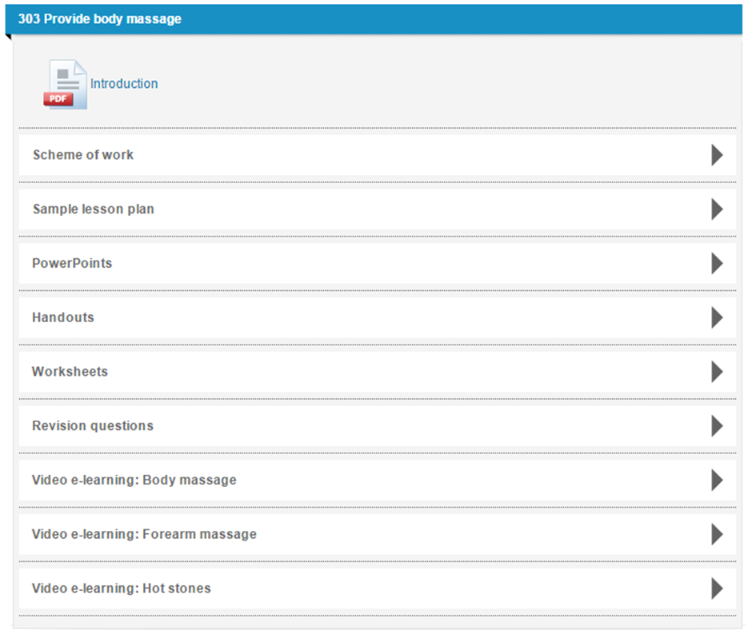
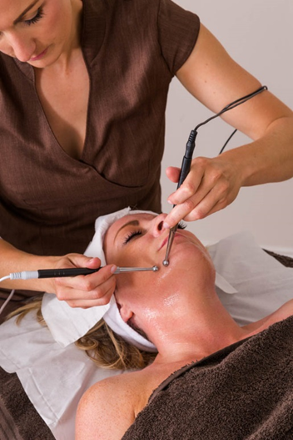
BEAUTY SMARTSCREEN
SMARTSCREEN resources provided for each unit:
Introduction
Sample scheme of work
Sample lesson plan
PowerPoints
Hand-outs
Activities
Revision worksheets
Notes:
We will now look at the two main elements of TechBac in more detail, starting with Technical Qualifications.
Our new City & Guilds Technical qualifications have been designed and endorsed by employers, providing up to date and highly relevant skills with graded assessments. A practical and applied approach to assessment ensures that staff have more time to focus on teaching and learning, for more successful outcomes.
Technical qualifications are comprised of the following elements:
Synoptic assessment – this is assessment in which two or more areas of learning are brought together in a single assessment. This approach has been adopted for this qualification in order to help learners make connections between areas of learning and to promote holistic delivery and understanding of the subject. Synoptic assessments are comprised of a Practical Assignment and a written Examination.
The assignments are externally set, internally marked and externally moderated, and are designed to assess a specific optional task or area of the qualification. To do this, the candidate will be required to identify and use effectively an appropriate selection of skills, techniques, concepts, theories and knowledge from across the whole content area.
The examinations are externally set and externally marked, and will be sat online through City & Guilds’ computer-based assessment platform. The exam assesses the depth and breadth of the candidate’s understanding of the mandatory content of the qualification.
Employer Involvement - for the Key Stage 5 Technical Qualifications, Employer Involvement is a requirement that must be successfully met in order for learners to achieve the qualification. Although it does not contribute to the overall qualification grading, employer involvement in the delivery and/or assessment of these qualifications is essential for all candidates, and will therefore be externally quality assured by City & Guilds. The EQAs will review the centre employer involvement plans at approval stage, and then the Quality team will sample the evidence at cohort level, when the centre submits at the end of the academic year.
Optional Units - These assignments are externally set, internally marked and externally moderated, and are designed to assess a specific optional task or area of the qualification. To do this, the candidate will be required to identify and use effectively an appropriate selection of skills, techniques, concepts, theories and knowledge from across the whole content area
All elements are mandatory to achieve the Technical Qualification (although Employer Involvement is only a requirement for KS5 quals). However only the Synoptic Assessments contribute towards the final grade.
There is no Direct Claim Status for any of the components, so centres will no be able to claim results themselves.

Slide 29
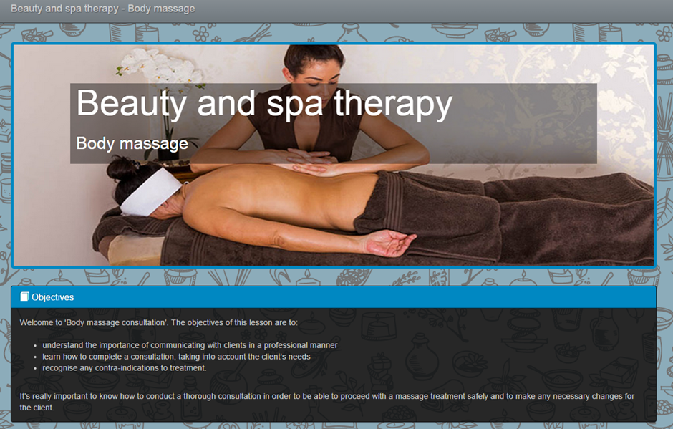
BEAUTY SMARTSCREEN PLUS
In addition, the following units also contain video e-learning:
303 Provide body massage
304 Provide facial electrotherapy treatments
305 Provide body electrotherapy treatments
306 Provide dry spa treatments
307 Provide electrical epilation
308 Provide Indian head massage
309 Tanning treatments
311 Provide individual semi-permanent
lash treatments
320 Provide hot stone treatments
Notes:
We will now look at the two main elements of TechBac in more detail, starting with Technical Qualifications.
Our new City & Guilds Technical qualifications have been designed and endorsed by employers, providing up to date and highly relevant skills with graded assessments. A practical and applied approach to assessment ensures that staff have more time to focus on teaching and learning, for more successful outcomes.
Technical qualifications are comprised of the following elements:
Synoptic assessment – this is assessment in which two or more areas of learning are brought together in a single assessment. This approach has been adopted for this qualification in order to help learners make connections between areas of learning and to promote holistic delivery and understanding of the subject. Synoptic assessments are comprised of a Practical Assignment and a written Examination.
The assignments are externally set, internally marked and externally moderated, and are designed to assess a specific optional task or area of the qualification. To do this, the candidate will be required to identify and use effectively an appropriate selection of skills, techniques, concepts, theories and knowledge from across the whole content area.
The examinations are externally set and externally marked, and will be sat online through City & Guilds’ computer-based assessment platform. The exam assesses the depth and breadth of the candidate’s understanding of the mandatory content of the qualification.
Employer Involvement - for the Key Stage 5 Technical Qualifications, Employer Involvement is a requirement that must be successfully met in order for learners to achieve the qualification. Although it does not contribute to the overall qualification grading, employer involvement in the delivery and/or assessment of these qualifications is essential for all candidates, and will therefore be externally quality assured by City & Guilds. The EQAs will review the centre employer involvement plans at approval stage, and then the Quality team will sample the evidence at cohort level, when the centre submits at the end of the academic year.
Optional Units - These assignments are externally set, internally marked and externally moderated, and are designed to assess a specific optional task or area of the qualification. To do this, the candidate will be required to identify and use effectively an appropriate selection of skills, techniques, concepts, theories and knowledge from across the whole content area
All elements are mandatory to achieve the Technical Qualification (although Employer Involvement is only a requirement for KS5 quals). However only the Synoptic Assessments contribute towards the final grade.
There is no Direct Claim Status for any of the components, so centres will no be able to claim results themselves.

Slide 30


Contact details:
Emma Mackay
Hair and Beauty Portfolio Manager
City & Guilds
Email: emma.mackay@cityandguilds.com
Tel: 07525813980
Diane Mitchell
Hair and Beauty Advisor
City & Guilds
Email: diane.Mitchell@cityandguilds.com
Tel: 07919415455

Slide 31

© CITY & GUILDS

